Slide 1
Flipping the Grade Six Math Classroom

Slide 2
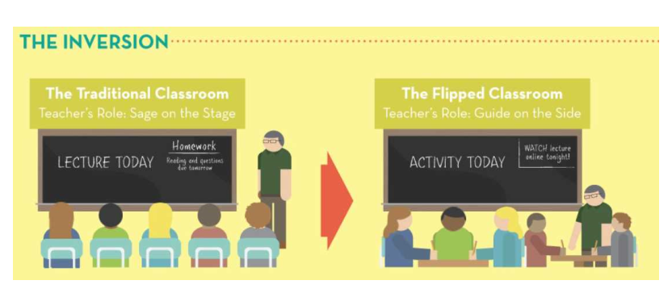
What is the Flipped Classroom?

Slide 3
What is a Flipped Classroom?
A flipped classroom “flips” the traditional order of teaching. Instead of learning being teacher-centered, it becomes student-centered.
Students can receive a more individualized math education. This results in students finding success at their level of understanding.
It encourages students to become more effective in time management and helps them learn how to take charge of their learning.

Slide 4
Benefits of the Flipped Classroom
Learning is student-centered. The focus is on the student practicing and producing quality work instead of the teacher teaching the content.
Students can learn at their own pace - pause and rewind videos.
Students are able to work with their peers collaboratively, and those who require more assistance have more time with the teacher.
Students who show understanding from viewing video are able to move on and extend their learning by engaging in higher-level thinking activities.

Slide 5
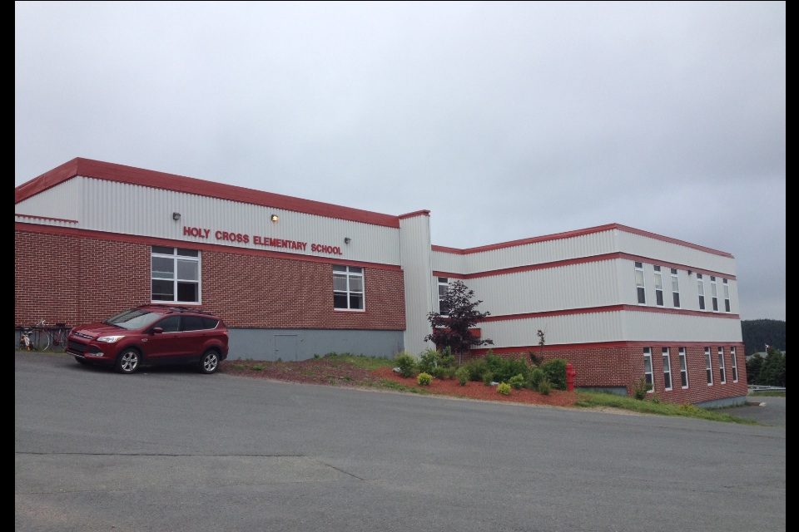
Background Information
Jennifer Kendell, Holy Cross Elementary, Holyrood: I have been teaching for 9 years and have spent the last 5 years teaching grade 6. For the last three years, I have been teaching at Holy Cross Elementary, a k-6 school of 240 students located in Holyrood. This year, my grade six math class is comprised of 17 students - 7 boys and 10 girls - with many students recognizing that they are visual and hands-on learners.
Meagan Careen, Holy Cross Elementary, Holyrood: I graduated from MUN in 2012 with a Physical Education and Secondary/Intermediate Education degree. I teach Physical Education and Grade 6 Math at Holy Cross Elementary, in Holyrood. In my grade six Math class, I have a total of 19 students - 8 boys and 11 girls.

Slide 6
Background Information
Janice Morgan, St. Matthew’s School, St. John’s: I have been teaching for 7 years, 3 of which have been in Grade 6. This year my class consists of 9 girls and 6 boys. I enjoy adjusting and reflecting upon my teaching practice to encourage motivation in all students.
Stephen Spratt, St. Matthew’s School, St. John’s: I have been teaching for 15 years with about 11 years in grade 6. A class of 6 boys and 3 girls. I believe that most children learn when they have an interest in the topic and it is hands-on, investigative and collaborative based.

Slide 7
Focus Area
Math was the subject area chosen with a concentration in Fractions.
Jennifer expressed an interest in creating a flipped classroom which steered our plan.
A collaborative approach between two schools and four teachers.
We researched various educational and scholarly articles viewed online.
We meet with a teacher who has implemented the flipped strategy into her secondary math classes.
Would a flipped classroom change the motivation level of our students in Math?

Slide 8
Research Questions
Our specific research question asked, “How would the implementation of the flipped grade six math classroom affect student motivation?”
In the beginning our question asked, “How would the implementation of the flipped grade six math classroom affect student achievement?”.

Slide 9
Ethical Considerations
We took ethical considerations into account by:
preparing a parent information letter.
having parents sign an Edmodo permission form.
having parents complete permission forms from Memorial University.

Slide 10
Planning
Gain understanding of the flipped classroom structure (books, articles, videos, teachers)
Decide math unit for first flipped classroom model
Discuss methods of data collection (questionnaires, observation, pictures, videos)
Technology – how to host videos, online classroom space
Permission and information for parents
Preparing activities

Slide 11
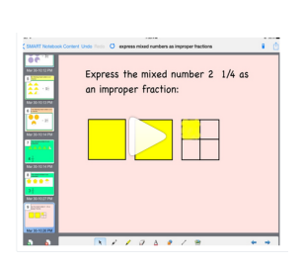
Implementation
1. Getting Started
Creation of videos was key to implementation of the flipped classroom
Both schools used either Show Me or Educreations to create videos, and used Edmodo as a platform for student communication

Slide 12
Implementation
2. Getting Students Ready to Flip:
Students completed a pre-unit motivational survey
Students practiced with an in-class video as a preview of what homework would be like - success!

Slide 13
Implementation
3. "Flipped" Homework
Students watched two videos per week.
Both schools used a homework chart, where students would record information and questions they had about the video.

Slide 14
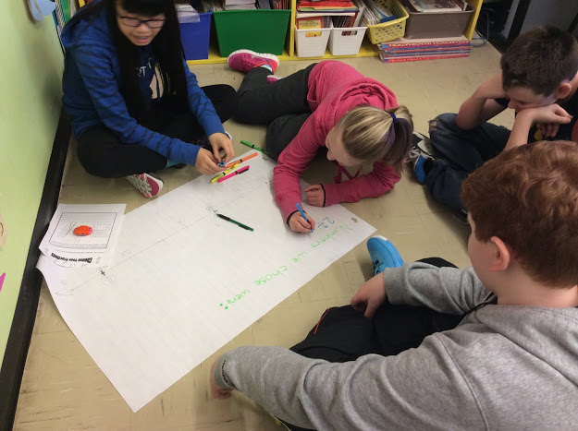
Implementation
4. What did our classrooms look like?
Centre work, games, problem-solving activities, manipulatives, whiteboards, iPads/devices - Active!
Lead to meaningful conversations about Math between students
Provided many opportunities to work with students one-on-one

Slide 15
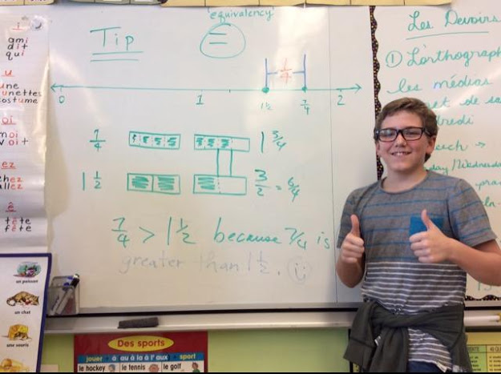
What did our classrooms look like?

Slide 16
Implementation
5. Data collection
Informal observation
Pictures, videos
Edmodo
Interviews
6. Conclusions
Increased student motivation, independence and responsibility
Integration of technology was well-received by students
Created an excellent learning environment

Slide 17
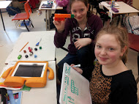
Results
Themes found in collected data from project:
The use of technology increased excitement and motivation in the grade six math class.
Students showed increased motivation to learn independently and took more responsibility in their learning.
The flipped class model was effective in increasing student motivation by providing opportunities for students to become engaged in meaningful ways.

Slide 18
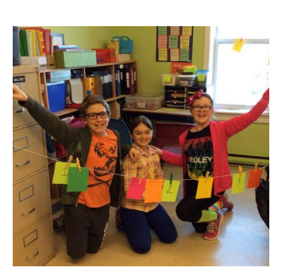
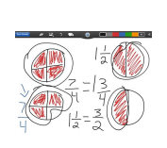
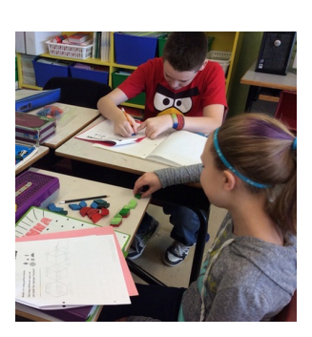
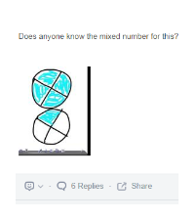
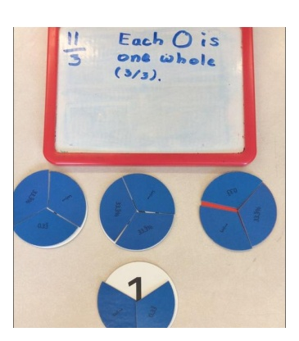
Jennifer’s Results

Slide 19
Jennifer’s Results
After implementing the flipped classroom model of teaching during the grade six fractions unit, I noted several changes that took place.
(1) My method of instruction was very different. Using the flipped model, students received their instruction prior to class, prepared to engage in activities that met their level of understanding.
(2) The flipped classroom allowed me to better meet the needs of my students as I had more opportunity to meet one-on-one with students that needed additional assistance while other students challenged themselves with appropriate activities.
Students were more engaged, communicated with one another more frequently, and had more opportunity to work collaboratively.
Students also responded positively and were eager to use our online platform, Edmodo, to communicate with one another about math.

Slide 20
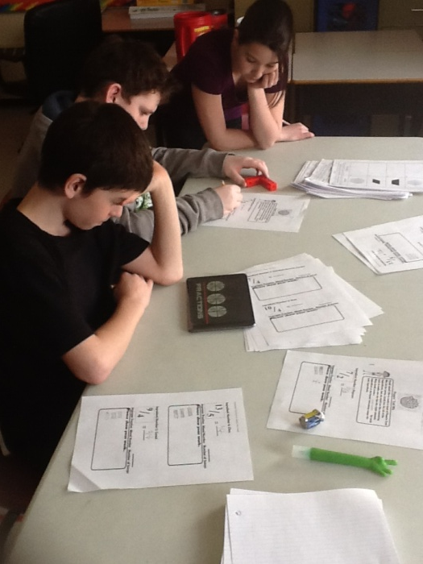
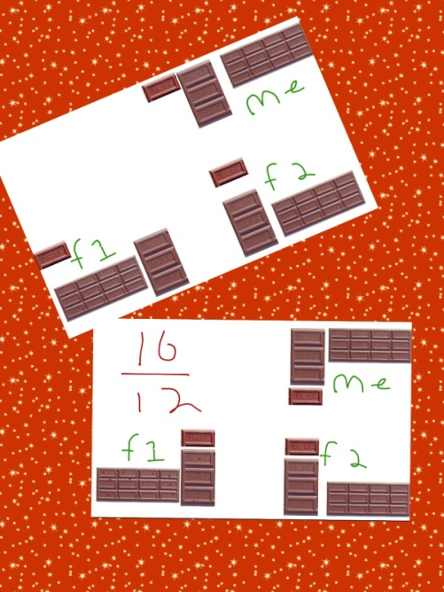
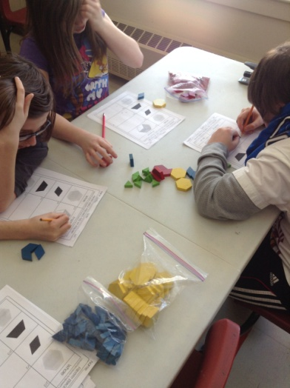
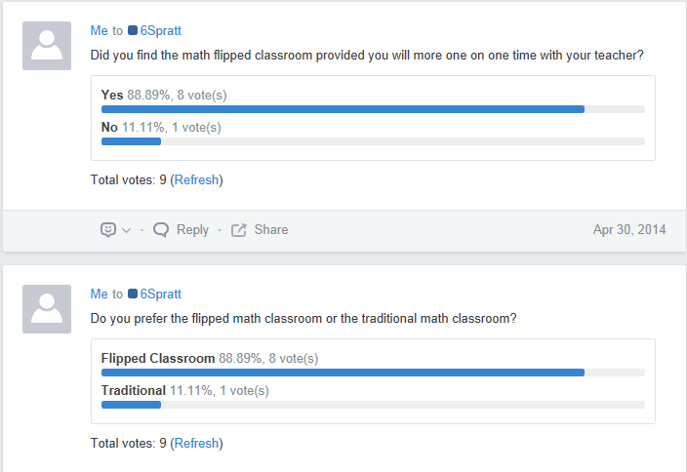
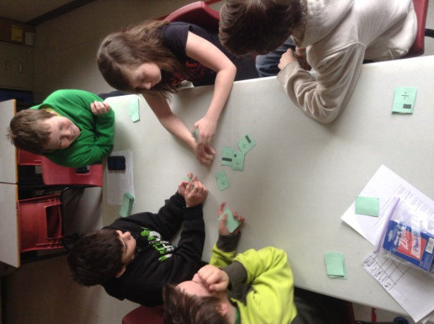
Stephen’s Results
What fraction of bar will each student get?
“I felt more prepared for class in the flipped model”
“Reviewing the video is a great help!”

Slide 21
Stephen’s Results
Throughout the development and implementation of this project I was able to discuss the subject of fractions and develop various assessments to meet the many needs of my students with our team of teachers. Learning a new model for teaching was also very informative and benefited me as an educator. I was able to add to my regiment of teaching through a learning process. I was also able to open my classroom to allow more group based inquiry learning with improved one on one time with my students. When a student says that they felt more comfortable coming to class because they had more knowledge and felt prepared you feel that this teaching strategy motivates and builds self-esteem which encourages me to continue this style.

Slide 22
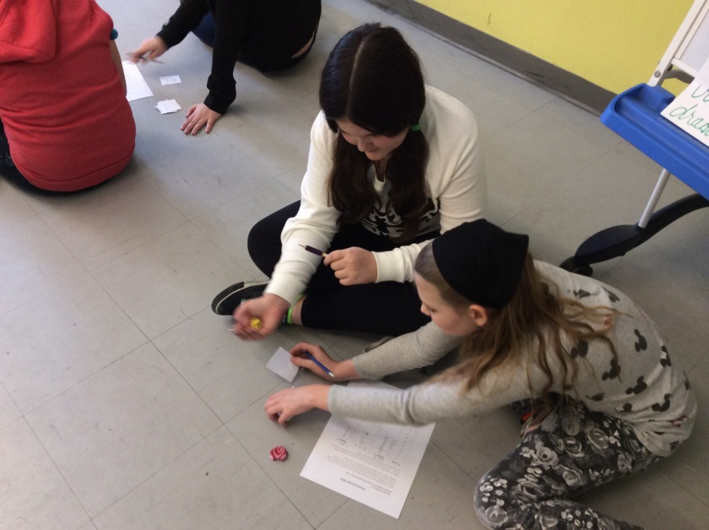
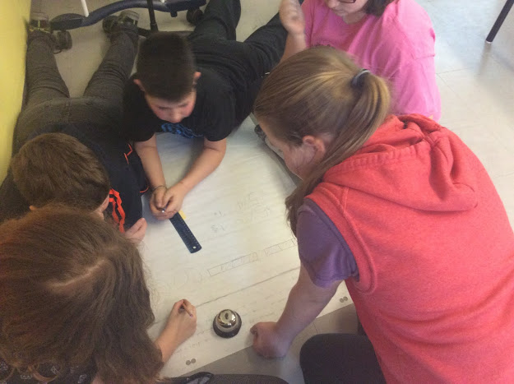
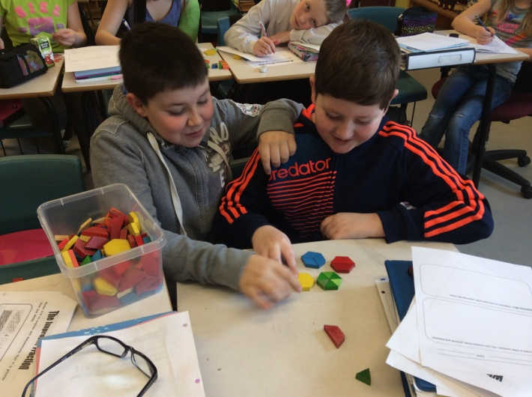
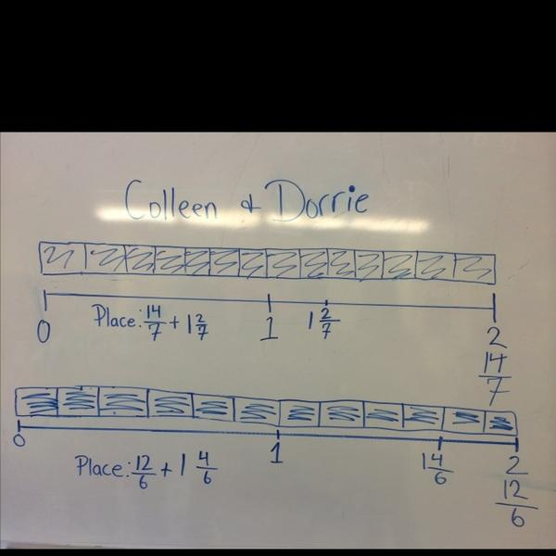
Meagan’s Results

Slide 23
Meagan’s Results
My involvement in this project deepened my understanding of teacher inquiry and it’s value as a meaningful professional development for teachers. Learning a new model for teaching this early in my career was also very informative and benefited me as an educator.
The flipped classroom allowed me to better meet the needs of my students as I had more opportunity to meet one-on-one with students who needed extra support.
Students were more engaged in my classroom. My students were excited to come into the classroom to learn math. Before I implemented the flipped classroom, I often heard, “Can we go to the gym today instead of Math?”, which was later turned to, “Are we working with the I-pads in Math today?”.
The flipped classroom encouraged a greater feeling of independence and responsibility for students. Students enjoyed learning at home, while still being able to communicate with their teacher and peers via Edmodo. I used the curriculum guide to prepare my "script" for my flipped videos. Teaching Grade 6 Math for the first time, this method of teaching allowed me to gain a greater understanding and in-depth knowledge of curriculum outcomes.

Slide 24
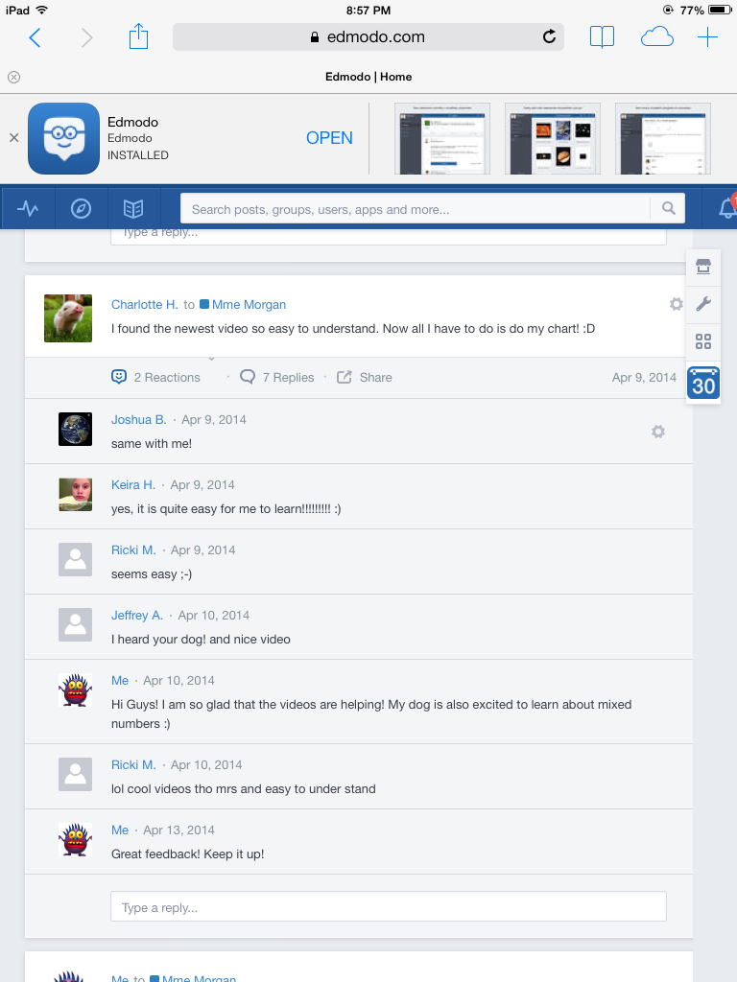
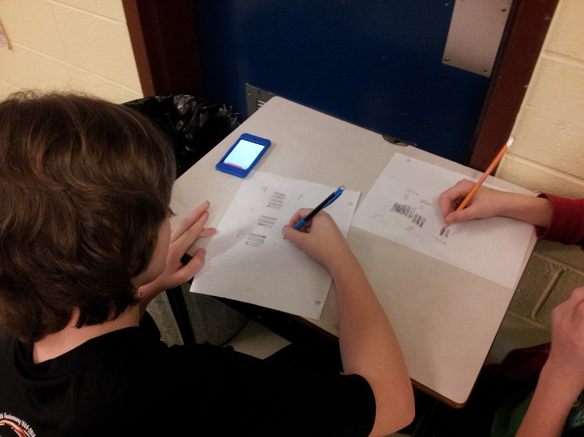
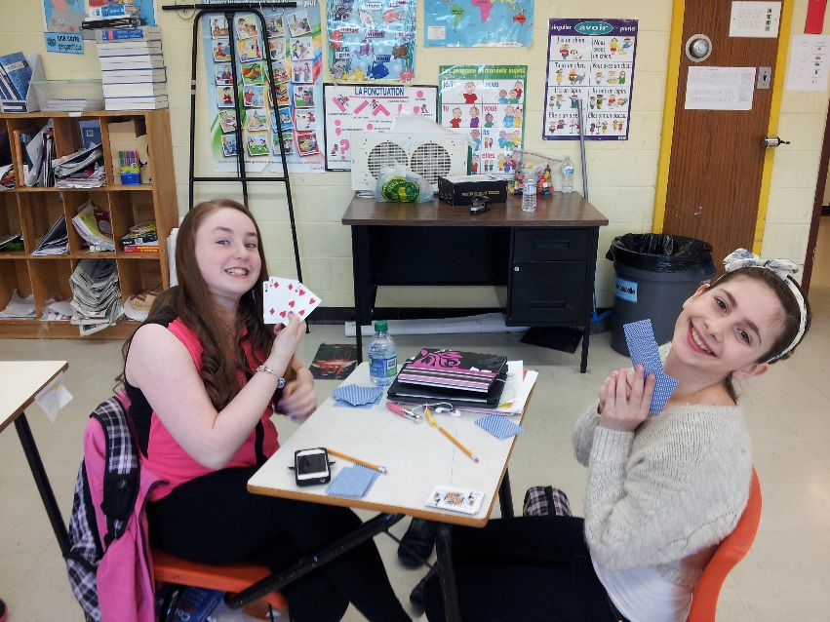
Janice’s Results
Students readily engaged in Math conversations based on videos using Edmodo.
All students reported they would like to use this method again. “I liked going home every night and learning about Math.” ☺
Students came to class prepared and motivated to work using various technologies. “I loved how we used technology a lot more!”

Slide 25
Janice’s Results
I believe my knowledge of teaching and learning has been enhanced through my participation in this project. For instance, the flipped classroom allowed me to engage with the curriculum in ways I had not done before. I used the curriculum guide to prepare my "script" for my flipped videos. The preparation for each lesson assured that I would not forget to remind students about helpful hints, as these hints would already be embedded in the lesson. The nature of the flipped classroom also encouraged reflection upon my own teaching practices, as I was able to review and re-record lessons as necessary. I did, admittedly, experience some discomfort, when I first started the flip. However, once I saw the level of engagement students had, in addition to the in-depth nature of their understanding, I embraced the new environment of the flipped classroom. The flipped classroom encouraged a greater feeling of independence and responsibility for students. Students enjoyed learning at home, while still being able to communicate with their teacher and peers via Edmodo. I will certainly use this teaching method again, as I have seen the benefits this style offers for many types of learners. The flipped classroom enables all students to feel "smart", and therefore is a powerful motivational tool for educators.

Slide 26
Teacher Inquiry
Utilized survey data and interviews with students to help lead the next lesson or activity.
We could collaborate with other teachers and discuss our teaching along with data from various literature.
Developed research to gain insights in new teaching styles and strategies.
Provided us with professional development to help foster not only the learning of our students but our own learning.

